Slide 1

E4SEM1 MAJOR PROJECT-1
Plant Leaf Disease Detection Using CNN(ResNet) – Deep Learning
Under the guidance of:
B.Madhan Mohan Sir,
HOD OF ECE,
RGUKT RKVALLEY,KADAPA.
Team Members:
T.Sai Yogesh(R170268) A.SubbaRayudu(R170979)
O.Venkata Krishnaiah(R170452)
DEPARTMENT OF ELECTRONICS AND COMMUNICATION ENGINEERING,
RAJIV GANDHI UNIVERSITY OF KNOWLEDGE TECHNOLOGIES,
RK VALLEY,KADAPA(DIST),ANDHRA PRADESH,PINCODE-516330.
DECEMBER-2022.

Slide 2
CONTENTS
Introduction
Abstract
Problem Statement
Steps to Solve the Problem
Block diagram
Dataset Creation and Model Training
Deep Learning and CNN
Tools and Frameworks
Classification
Advantages
Conclusion

Slide 3
INTRODUCTION
In India 70% of population people depends upon agriculture and Farmers experience great difficulties in switching from one disease control policy to another.
The naked eye observation of experts is the traditional approach, this method can be time consuming, expensive and inaccurate.
The crop losses can be minimized by applying pesticides if diseases are correctly diagnosed and identified early.

Slide 4
ABSTRACT
The major reason for minimizing crop productivity is various diseases in Plants .
To eliminate the disease-induced losses in plants during growth as well as to increase crop productivity.
This project works on the technique of image processing which identifies the various diseases in plants gives remedies and avoids plant deficiencies.

Slide 5
Here we use an efficient Convolutional neural network (CNN) RESNET Model- algorithm which can detect the type of diseases in images.
ResNets are one of the most efficient Neural Network Architectures, as they help in maintaining low error rate with much deeper in the Network.

Slide 6
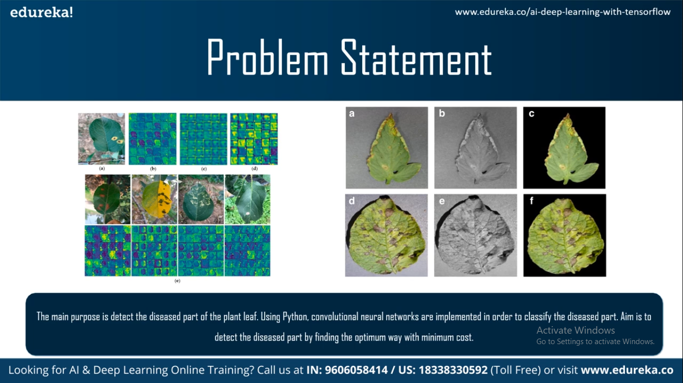
Problem Statement
The main purpose is to detect the diseased part of the plant leaf,using python and cnn implemented in order to clasify the diseased plant.

Slide 7
Steps to Solve the Problem
Steps :
Start(Block Diagram/Flow Chart)
Prepare a database (healthy or diseased)
Training & Validating CNN Model
Test images using network Resnet Model
Classification/Predicted Output

Slide 8
Block Diagram
Input leaf image
Image
Pre-Processing
Image
Segmentation
Feature Extraction
Neural-Network
classification
Healthy
Diseased

Slide 9
Training Phase
Testing Phase
Datasets
Of Image
Input Image
Image Acquisition
Image Acquisition
Image Processing
Image Processing
Image Segmentation
Image Segmentation
Feature Extraction
Feature Extraction
Healthy
Classification using Neural Networks
Datasets
Disease

Slide 10


Slide 11
Dataset Creation
The Main Dataset source related to the Plant Diseases can be downloaded from Kaggle ,a Popular Online Machine Learning Community Platform .
The Data from the data set is splitted into :
1)Training 2)Validation 3)Testing Datasets.
The Training & Validation datasets are used to Train and fit the model with the data and Testing set is used to predict the Output / Classification.

Slide 12
Deep Learning
Deep learning is a subfield of Machine Learning(ML) concerned with algorithms inspired by the structure and function of the brain like structure known as Artificial Neural Networks.
Deep Learning systems can improve their performance with access to more data,the machine version of more experience.
Machines have gained enough experience from the labelled data and algorithms.
Results like Driving a car, Detecting weeds in a field of crops, Detecting diseases, Inspecting machinery to identify faults,etc

Slide 13
Convolutional Neural Networks (CNN)/RESNET
In deep learning , RESNET (Residual Network) is a convolutional neural network (CNN or CovNet) is a class of deep neural networks are most commonly applied to analyze visual imagery.
CNNs are designed to process data through multiple layers of 2D arrays and its applicable for pattern recognization and Computer Vision Applications.

Slide 14
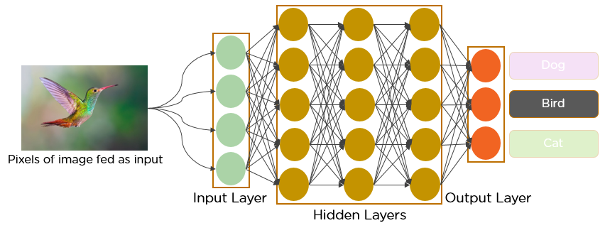
CNN Working Model

Slide 15
Tools and Frameworks
Open source Tools : Google Colab Notebook (GPU) using Python
Machine Learning Tools:
Tensor Flow
Pytorch.
Data Analysis Tools:
Pandas
Numpy
Data Visualisation Tools:
Matplotlib

Slide 16
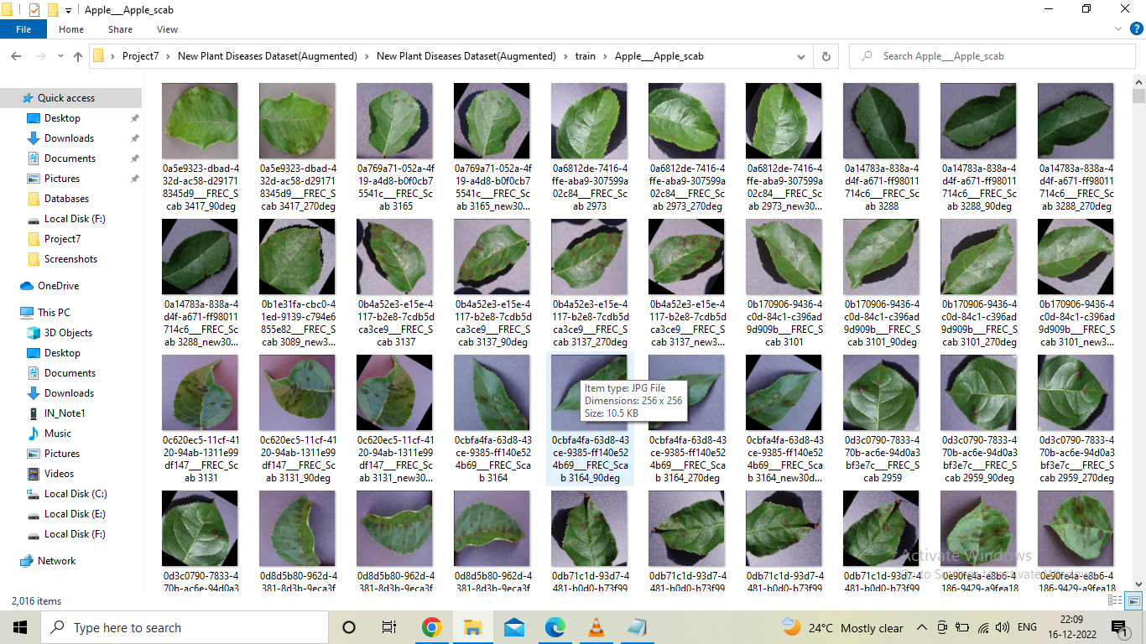
Training Dataset

Slide 17
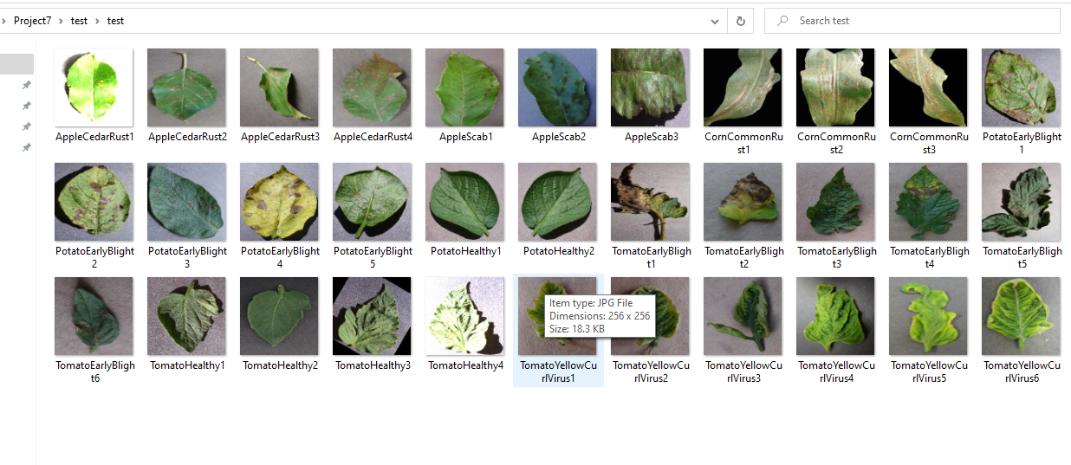
Testing Dataset

Slide 18
The Training Dataset contains of 70k images that are used to train the model in order to get a good prediction.
The Validation dataset is useful for model to better fit the data and tuning the Model for better Accuracy Prediction.
The Testing Data set is used to Evaluate the performance of the model and gets accurate Output.

Slide 19
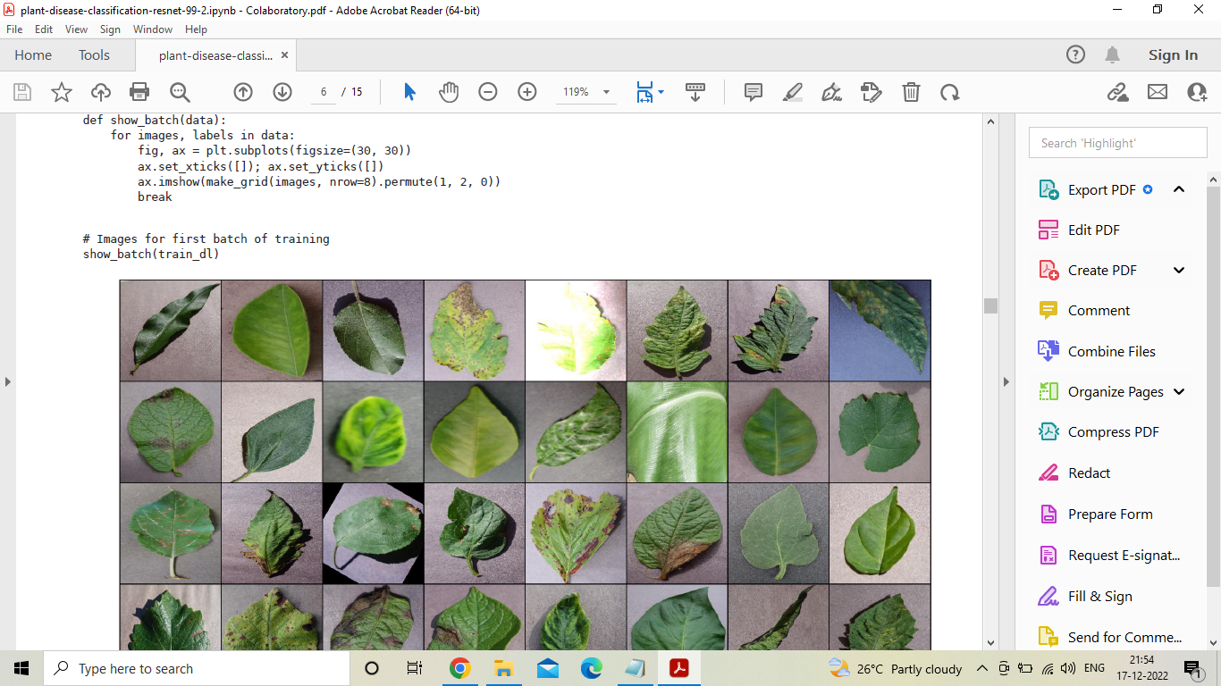
Training and Validating Model
First the Model is Created by Importing required Libraries and then the the model is trained with Train and Valid Datasets.

Slide 20
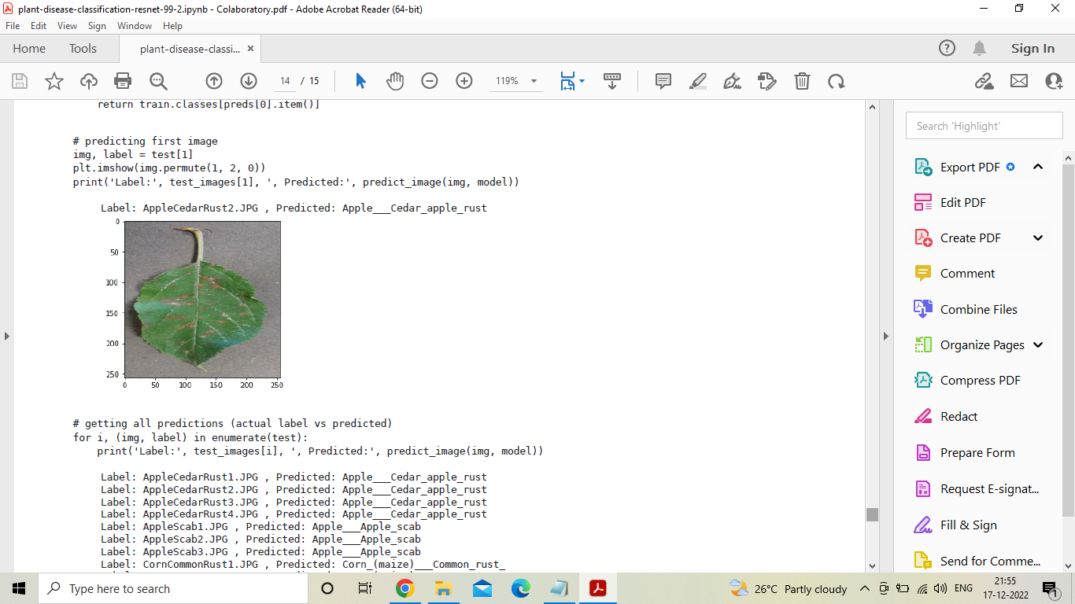
CNN Classification (Prediction)
The Input Image is given to the Model from Test Dataset and the Model Classifies and Predicts the Output( Plant Disease Type).

Slide 21
ADVANTAGES
The main advantage of automatic plant disease detection is to protect crop production from quantitative losses.
Automatic detection of plant disease is essential part of monitoring large fields of crops.
It can be implemented to increase crop productivity by ensuring the quality and quantity of the food product.

Slide 22
The advantage of automatic plant disease detection and classification is to provide best Agricultural productivity.
It provides the better advancement and enhancement in computing classifiers of a neural network approach and provide better results.
This system will be capable of distinguishing a large no of different diseases in a less time.

Slide 23
CONCLUSION
Plant leaf disease detection predicted by using Resnets CNN algorithm model with 99.3% accuracy.
Grape, corn, tomato, apple, and blueberry are some of those species on which proposed algorithm was Successfully trained and tested.
Predicted output obtained with less cost and high performance in Classification of plant disease detection.

Slide 24
THANK YOU

